Slide 1
Live from antlia
A Game by Bruno, Michael and TK

Slide 2
Idea and Overview
2D Card Game with a political twist.
Science Fiction with a wacky feel.

Slide 3
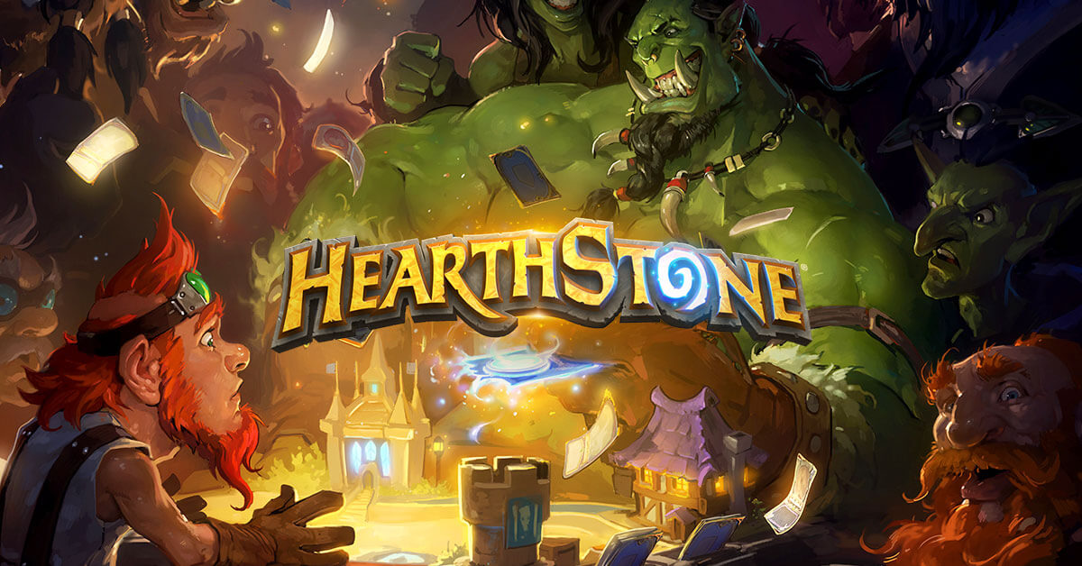
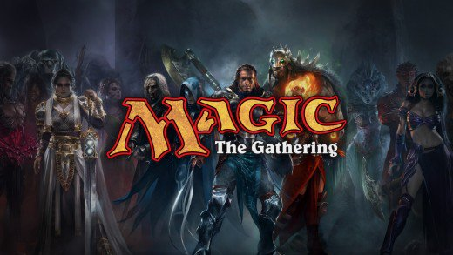
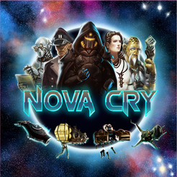
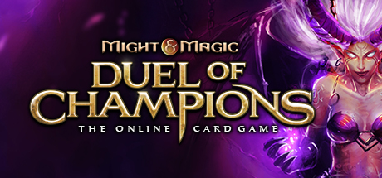
Influence and Research

Slide 4
Why Unity?
Previous Experience
Lots of utilities.
All members comfortable with it.

Slide 5
Gameplay and Mechanics
Turn-based.
3 Bars : Integrity, Funding and Popularity.
Conspire Cards.
Stress Cards.
Outsmart your opponent to win.

Slide 6
Game Demo

Slide 7
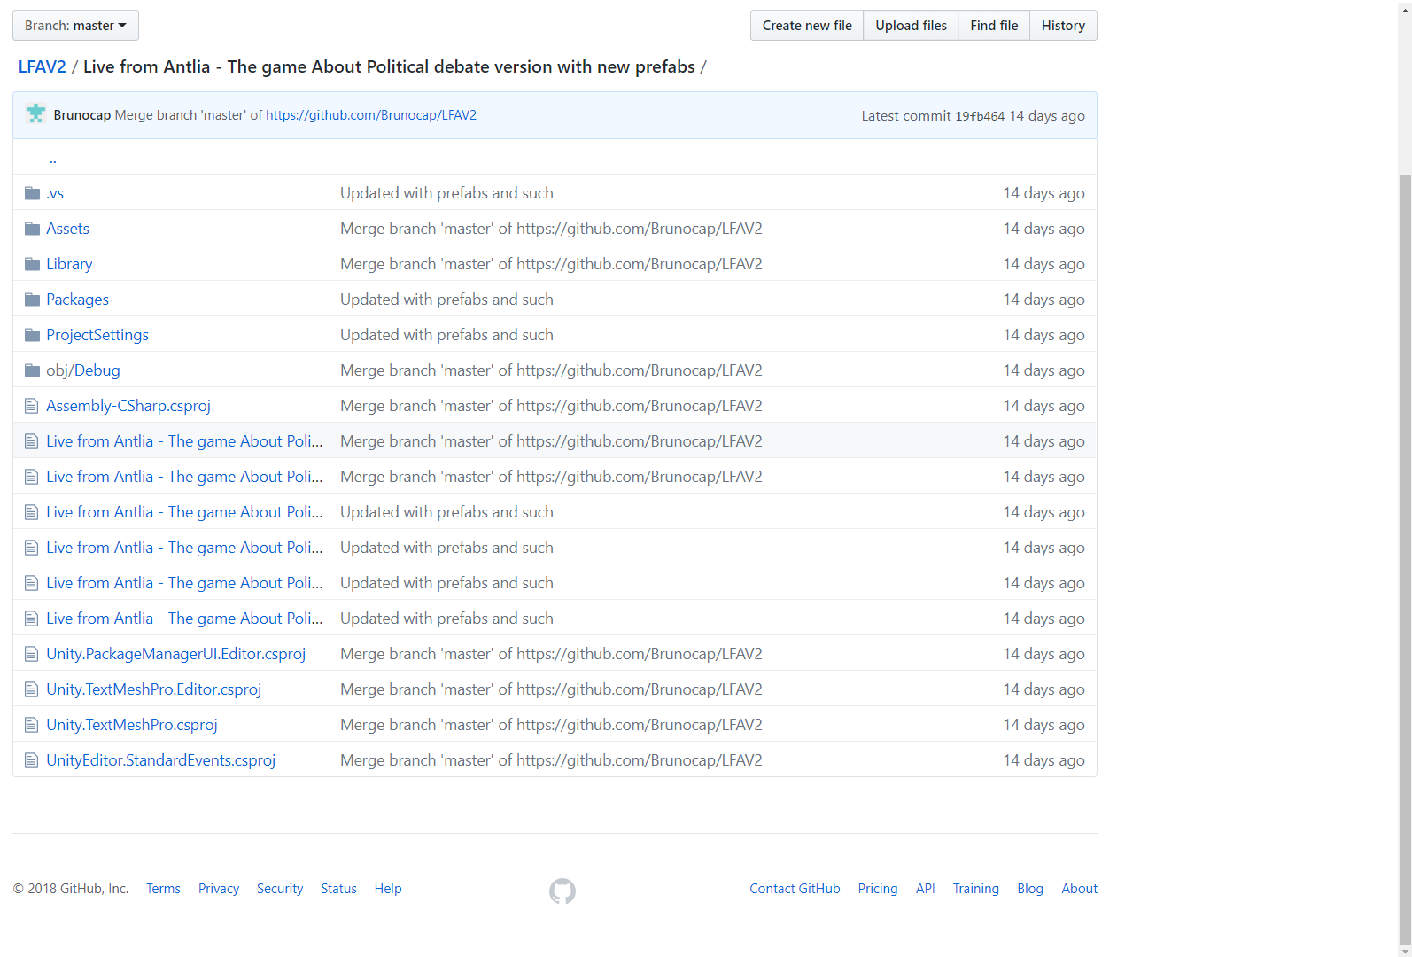
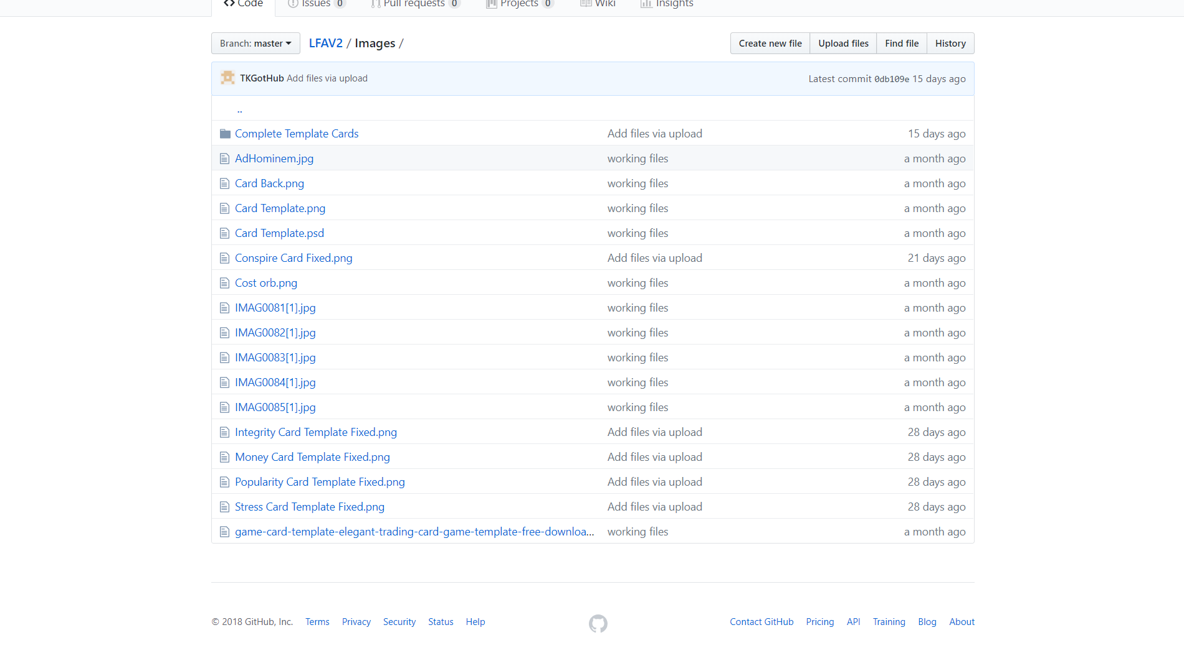
Immersive Qualities and Version Control

Slide 8
Contributions to the Project
Bruno : Lead Programmer / Writer
Michael : Documentation /Programmer
TK : Art / Writer /Design

Slide 9
What We Learned

Slide 10
Thank You For Listening. Questions?

